Slide 1
Lane Detection
Zhanwei Zhang, Jianan Xie

Slide 2
Content
Background, Motivation, and Related Work
Innovation
Methodology
Current Results
Expected Results
Timelines

Slide 3
Motivation

Slide 4
Background

Slide 5
Related Work

Slide 6
Innovation

Slide 7
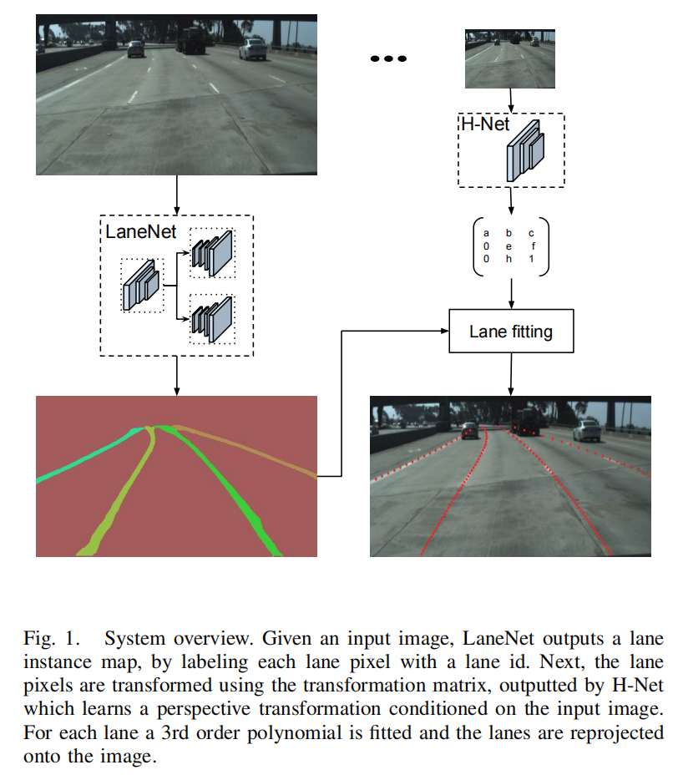
System Overview

Slide 8
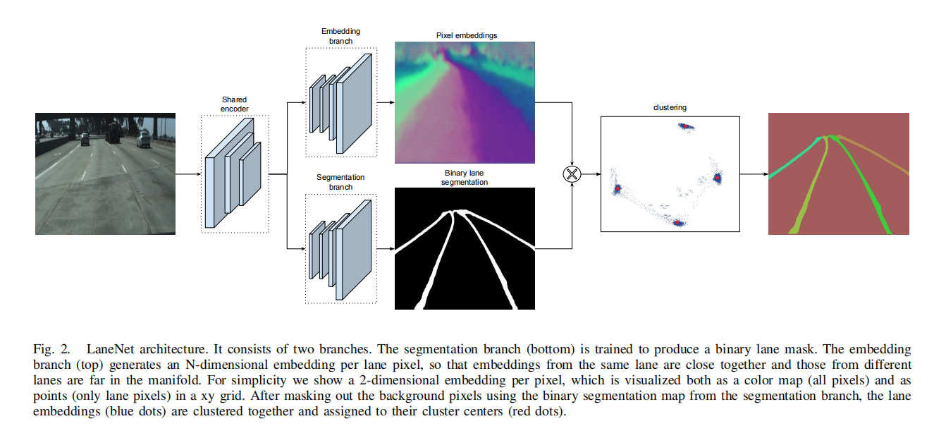
LaneNet Architecture

Slide 9
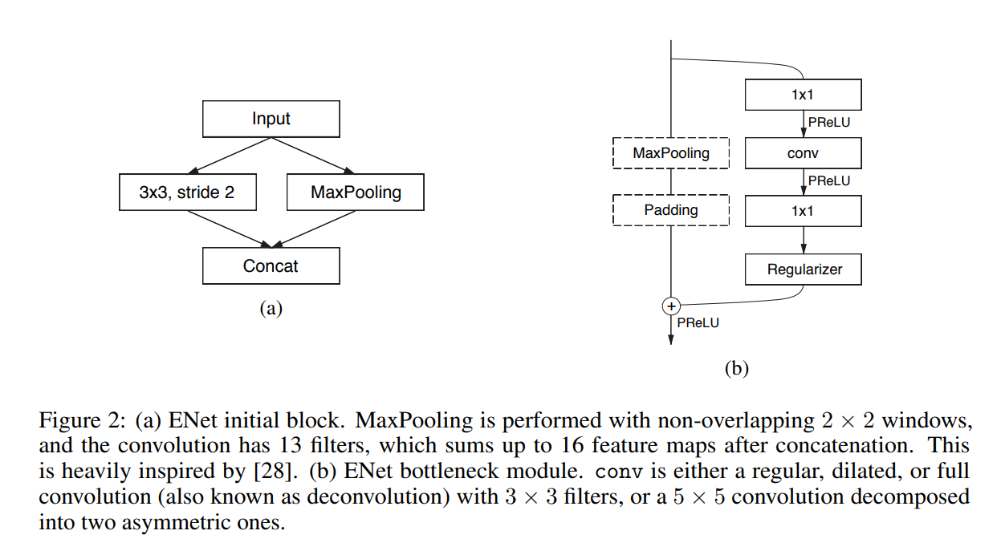
ENet

Slide 10
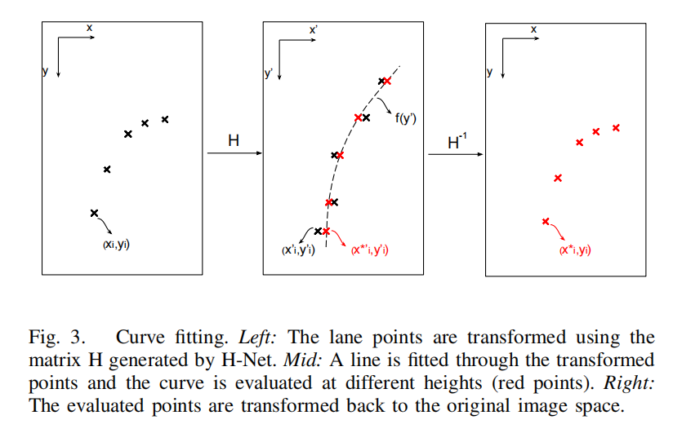
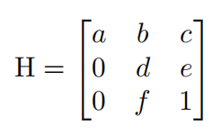
Curve Fitting and H-Net

Slide 11
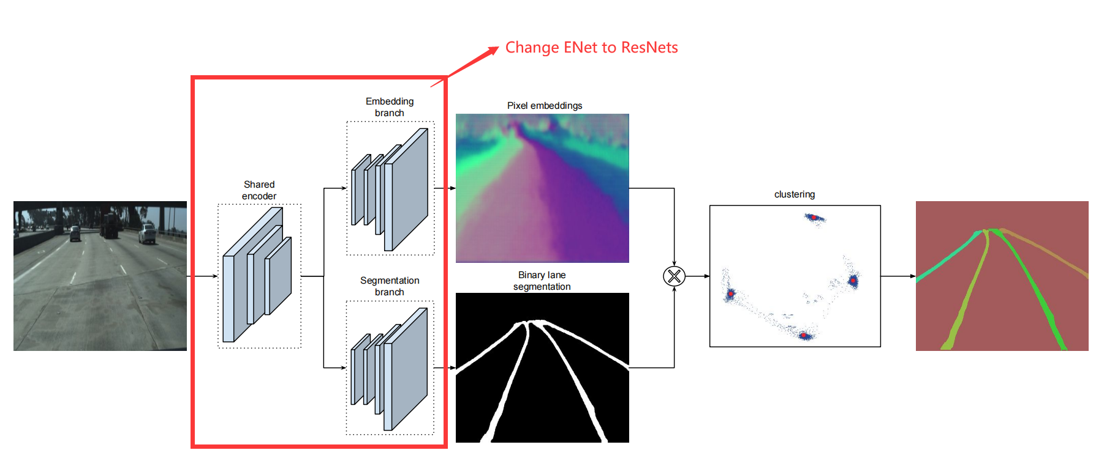
Methodology

Slide 12
ResNets
Notes:
更深的网络结构: ResNet通过引入残差连接解决了深度神经网络训练中的梯度消失问题，这使得它可以成功地训练更深层次的网络，而更深的网络通常能够学习到更抽象和复杂的特征表示。
更好的特征传递: ResNet的残差模块设计使得输入信息可以通过跳跃连接直接传递到后续层，这有助于网络在进行深层特征学习时保持信息的完整性。
广泛的应用: ResNet在多个视觉识别任务中表现出色，例如图像分类、目标检测和语义分割，在这些任务中它经常作为基础网络（backbone）使用。
转移学习性能: ResNet在转移学习方面表现优异，预训练的ResNet模型可以很容易地适应新的任务和数据集，这使得它在处理少量数据时仍然能够达到很好的性能。
研究基础扎实: ResNet自提出以来，已经有大量的研究基于其架构进行优化和扩展，形成了一个坚实的研究基础和社区支持。
相比之下，ENet的设计目标是在保持较低计算复杂度的同时进行有效的视觉任务处理，它在需要快速和高效处理的应用场景（例如移动设备或实时系统）中表现较好。然而，当模型复杂度和准确度成为更重要的因素时，ResNet通常是更佳的选择。

Slide 13
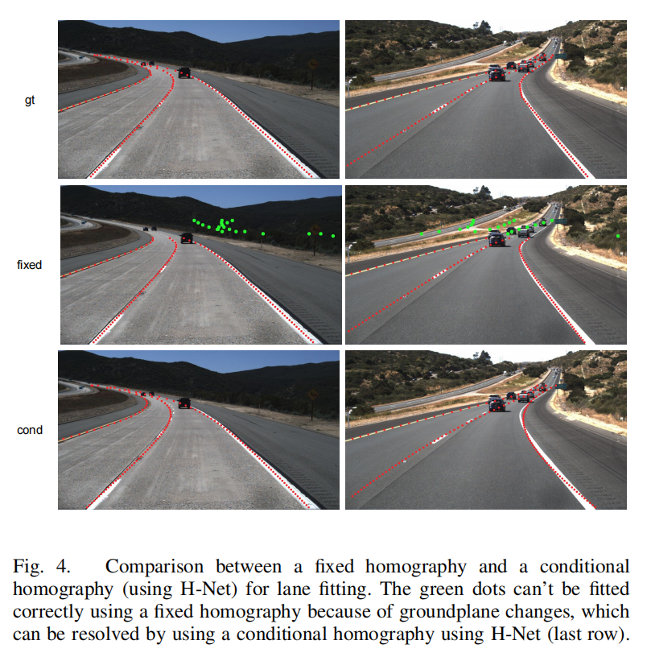
Curve Fitting and H-Net

Slide 14
Current Results
We observe the outcomes of applying a pre-trained model from a lane detection study to the SUSCape dataset as shown.

Slide 15
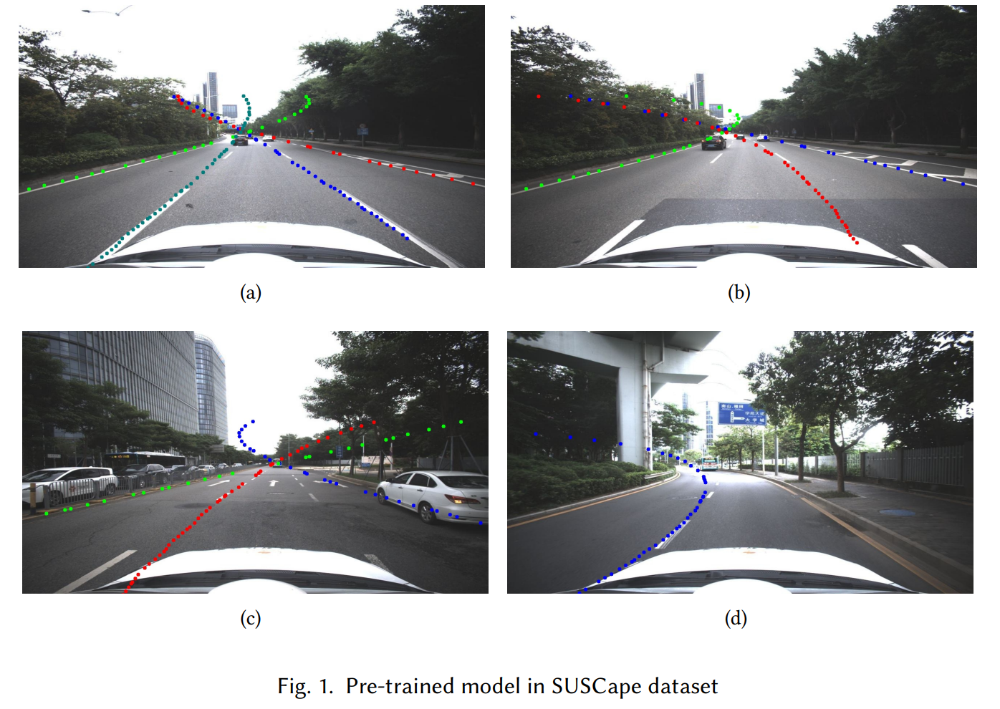
Current Results

Slide 16
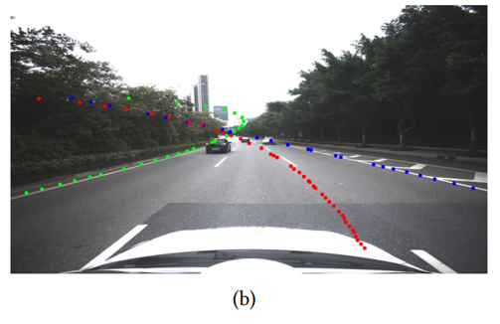
Current Results
Primary issues were identified in the results:
Incomplete Lane Detection
Excessive Lane Fitting Extension

Slide 17
Potential Causes
The discrepancy between the pre-training data (TUSample) and the SUSCape dataset may be significant.
predominantly blue sky and lower camera angles in TUSample
H-Net derived from the TUSample may lead to significant projection deviations and fitting extension.

Slide 18
Expective Results
Retrain with CULane. (Week 1~2)
Replace the encode from ENet to ResNeSt. (Week 1~2)
Improved Lane Detection (Week 2~3)
Promote the effect in SUSCape dataset.
Test in CULane test set.

Slide 19
References
[1] M. T. Smith A. Borkar, M. Hayes. 2012. A Novel Lane Detection System With Efficient Ground Truth Generation. IEEE Trans. Intelligent Transportation Systems (2012).
[2] S. Kim E. Culurciello A. Paszke, A. Chaurasia. 2016. ENet: A deep neural network architecture for real-time semantic segmentation. CoRRabs/1606.02147 (2016).
[3] Ziye Chen, Kate Smith-Miles, Bo Du, Guoqi Qian, and Mingming Gong. 2023. An Efficient Transformer for Simultaneous Learning of BEV and Lane Representations in 3D Lane Detection. arXiv:2306.04927 [cs.CV]
[4] S. Reuter M. Szczot M. Konrad K. Dietmayer H. Deusch, J. Wiest. 2012. A random finite set approach to multiple lane detection. ITSC (2012).
[5] Z. Zhang et al. H. Zhang, C. Wu. 2020. Resnest: split-attention networks. arXiv:2004.08955
[6] Kaiming He, Xiangyu Zhang, Shaoqing Ren, and Jian Sun. 2015. Deep Residual Learning for Image Recognition. arXiv:1512.03385 [cs.CV]
[7] Ma Z. Liu C. Loy C. C Hou, Y. 2019. Learning lightweight lane detection cnns by self attention distillation. In Proceedings of the IEEE/CVF international conference on computer vision (2019).

Slide 20
References
[8] C. Park J. Kim. 2017. End-to-end ego lane estimation based on sequential transfer learning for self-driving cars. Proceedings of the IEEE Conference on Computer Vision and Pattern Recognition Workshops (2017).
[9] M. Xu P. Lv X. Zhao J. Niu, J. Lu. 2016. Robust lane detection using two-stage feature extraction with curve fitting. Pattern Recognit (2016).
[10] De Brabandere B. Georgoulis S. Proesmans M. Van Gool Neven, D. 2018. Towards end-to-end lane detection: an instance segmentation approach. IEEE intelligent vehicles symposium (IV) (2018).
[11] A. Ismail G. Adam V. Narayan M. Schulze S. Chougule, N. Koznek. 2018. Reliable multilane detection and classification by utilizing CNN as a regression network. Proceedings of the European Conference on Computer Vision(ECCV) (2018).
[12] J. Shin Yoon S. Shin O. Bailo N. Kim T.-.H. Lee H. Seok Hong S.-.H. Han I. So Kweon S. Lee, J. Kim. 2017. Vpgnet: vanishing point guided network for lane and road marking detection and recognition. Proceedings of the IEEE International Conference on Computer Vision (2017).
[13] Berriel R. Paixao T. M. Badue C. De Souza A. F. Oliveira-Santos T Tabelini, L. 2021. Keep your eyes on the lane: Real-time attention-guided lane detection. In Proceedings of the IEEE/CVF Conference on Computer Vision and Pattern Recognition (2021).
[14] D. Neven M. Proesmans L. Van Gool W. Van Gansbeke, B. De Brabandere. 2019. End-to-end lane detection through differentiable least-squares fitting. Proceedings of the IEEE International Conference on Computer Vision Workshops (2019)

